Slide 1
Optimizing Acupuncture Treatment using Stress Monitoring
Development of a Heart Rate Variability Protocol for Use in the Acupuncture Clinic
Notes:
There are lots of interesting aspects to this technology, which I won’t be able to get to.

Slide 2
Balance of Pragmatic and Theoretical Concepts
Notes:
Balance pragmatic uses of hrv monitoring, but also want to discuss some of what I think is the potential and even the beauty of this subtle sort of monitoring and how it can shed light on what is happening at a more subtle physiological level

Slide 3
HRV May Help to
Identify clinical responders versus clinical non-responders
Show that acupuncture can reduce stress over time in addition to clinical symptom improvement
Optimize needling and treatment strategies
Notes:
The basics of what I hope to get across today is that the third of which is still quite speculative, so I hope we have time to get into that topic
I also hope to have time to discuss some applicability going forward with some new technologies being developed
I am fully aware that these studies are descriptive and far from air tight with no blinding, sham controls etc…

Slide 4
Why I became interested in Heart Rate Variability
Frustrated with lack of predictability
Patients with dramatic improvement
Patients with no improvement
WHY?
Notes:
As I hope you will see, I started out looking at stress levels but got into much more interesting territory.

Slide 5
Why I became interested in Heart Rate Variability
What is the physiology?
Gating as a mechanism for pain, but what about allergy? Anxiety?
Pain, mood, immune function and aging
Stress as a common denominator
Notes:
Trained as an anesthesiologist, I became curious about the physiology
For pain syndromes, I understood about gating, but what about allergy? Anxiety?
I remembered vaguely a presentation at the yearly Anesthesia conference about heart rate being able to predict more than just heart function

Slide 6
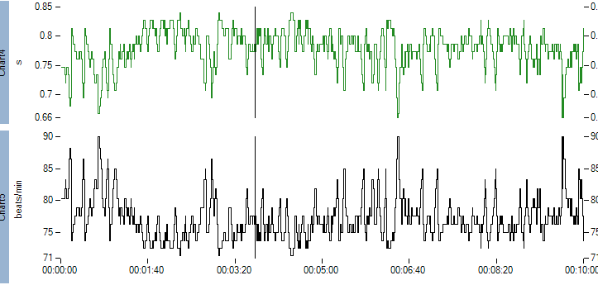
What is Heart Rate Variability Monitoring?
Noninvasive Method of measuring autonomic balance using computer analysis of the variability of heart rate with breathing
Notes:
Looks at autonomic balance
Aversely affected by age, mood, and illness they are using to assess risk in the Icu and other applications
For purposed of this talk hrv is stress
This is a typical 10 minute heart rate tracing HR and above interbeat interval

Slide 7
HRV in Ancient Times
“Variable heartbeat has been considered a sign of good health since the third century by oriental physicians and the scientist Wang-Shu Ho. Ho stated, “If the pattern of the heartbeat becomes regular as the tapping of woodpecker or the dripping of rain from the roof, the patient will be dead in four days.”
Ahn AC, Nahin RL, Calabrese C, et al. Applying Principles from Complex Systems to Studying the Efficacy of CAM Therapies. J Altern Complement Med. 2010;16(9):1015–22.
Notes:
It turns out that this variability declines with stress, age, illness. Using variability to analyze people’s gaits in the same way.
Indeed

Slide 8
HRV Measures Autonomic Balance: Stress Levels
Notes:
Balance between sympathetic and parasympathetic branches of the autonomic nervous system

Slide 9
Heart Rate Tracing, Variability!

Slide 10
Between Heaven and Earth

Slide 11
Ocean Beach

Slide 12
Why I became interested in Heart Rate Variability
Heart Rate Variability shows autonomic input
HRV is able to detect subtle nonlinear, physiological changes and acupuncture is a subtle physiological input
Notes:
It turned out to be especially fortuitous because HRV is able to pick up subtle, nonlinear physiological changes which has become the focus of my exploration and the foundation of the protocol I use.
In living nature a degree of variability is, well natural.

Slide 13
Notes:
We are getting more evidence that acupuncture stimulation activates many different physiological pathways likened to tapping a spider web
Can we use analysis to show these more subtle physiologic changes? Taps into something called complexity science.
It turns out that this degree of variability is an intrinsic sign of health.

Slide 14
Applying Principles from Complex Systems to Studying the Efficacy of CAM Therapies
Terms such as adaptability, robustness, or health were previously considered qualitative terms and thus were quantitatively intractable. Yet, complexity science has identified analytical methods that can help assess these features
Notes:
Theoretical but

Slide 15
Applying Principles from Complex Systems to Studying the Efficacy of CAM Therapies
transformations from one state to another can happen gradually or precipitously.
Ahn AC, Nahin RL, Calabrese C, et al. Applying Principles from Complex Systems to Studying the Efficacy of CAM Therapies. J Altern Complement Med. 2010;16(9):1015–22.
Notes:
Theoretical but

Slide 16
Applying Principles from Complex Systems to Studying the Efficacy of CAM Therapies
Because heart rate is dynamically balanced through many elements, the heart theoretically should be responsive to, and exhibit increased complexity across, multiple time scales in concert with fluctuations in these elements.” Ahn AC, Nahin RL, Calabrese C, et al. Applying Principles from Complex Systems to Studying the Efficacy of CAM Therapies. J Altern Complement Med. 2010;16(9):1015–22.
Notes:
Theoretical but

Slide 17
Applying Principles from Complex Systems to Studying the Efficacy of CAM Therapies
Small perturbation can have large, unpredictable effects

Slide 18
Applying Principles from Complex Systems to Studying the Efficacy of CAM Therapies
Complex Systems are nonlinear, which means that the system response to a sum of inputs is not simply the sum of their separate responses

Slide 19
Why is Heart Rate Variability relevant to acupuncture? Pragmatic Concerns
HRV correlates with more definitive physiological parameters which are more expensive but much less convenient and accessible e.g.
Interleukin levels(inflammation)
Cortisol (stress)
Telomeres (Aging)
Autonomic balance Brain (fMRI)
Notes:
I would like to impress before we go further with my story, why I think HRV is relevant to acupuncture this is all in the handout with references
Frame research questions towards more fruitful ones
I started exploring HRV in my clinic years ago because of a chance lecture I heard by Robert Sapolsky. What he said was simply that stress affected Mood, Pain, Immune function, and aging. All of these are affected by acupuncture also, so I started using HRV and skin conductance to measure stress in the clinic. What I expected to find was that patients’ stress might decrease over time. What I found instead, was that the patient’s whose HRV showed a “relaxation response” or a decrease in stress in response to the needles, were patients who were more likely to get better with treatment. Skin conductance did not correlate to the same degree as HRV, so I stopped measuring it.

Slide 20
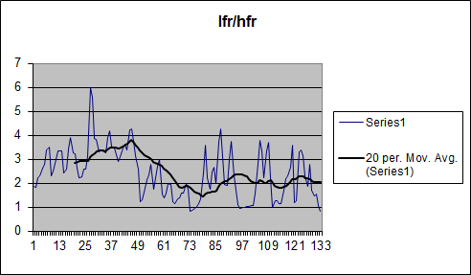
HRV Profile/Stress Reduction May Correlate with Successful Acupuncture Treatment
Responders show a decrease in their stress response during acupuncture treatment
Notes:
Applied for a variety of conditions Looked at outcomes and compared retrospectively
Comparing responders and non responders this has been shown
by a few other researchers also.
But what this also showed was that HRV may be able to show the subtle physiological shift that happens during acupuncture

Slide 21
Analysis of Heart Rate Variability in Acupuncture Practice: Can It improve outcomes?
http://www.ksparrowmd.com/wp-content/uploads/sparrow-research1.pdf
Notes:
Retrospective study comparing ultimate treatment outcomes and HRV profiles. So, no, there were no sham controls, not blinded. Retrospective study
A few other researchers have also found this phenomenon
Does this shift that is observed important? Would it be useful to try to maximize it and quantify it?

Slide 22
Acupuncture and Migraine and HRV
(Clin J Pain 2008;24:106–115)
Notes:
So pragmatically, this might help to guide treatment. When to continue and when to stop.

Slide 23
HRV May Help to
Identify clinical responders versus clinical nonresponders
Notes:
But something more interesting came out of this observation, which is that HRV may be a window into the various cascades of effects that acupuncture causes. More interesting than just stress reduction, may give us a window into what is happening

Slide 24
Acupuncture HRV Studies
Animals, healthy volunteers, patients with various conditions
Acupuncture points
EEG
FMRI
Skin resistance
GI Motility
Notes:
Vast majority of studies have been done in academic settings
Time frame has been over days to weeks
And there has been very little correlation with outcomes
But nonetheless we do have a large body of knowledge at this point

Slide 25
Does Acupuncture Reduce Stress Over Time? A Clinical Heart Rate Variability Study in Hypertensive Patients
http://www.ksparrowmd.com/wp-content/uploads/Does-Acupuncture-Reduce-Stress-Proof.pdf http://www.ncbi.nlm.nih.gov/pubmed/25352944
Notes:
One of the largest obstacles I have encountered in trying to put some kind of quantification on treatment is feedback. The standard feedback forms for mood or different outcomes are not acceptable for clinical practice because they are so long. They work for research studies, and indeed are required, but there is no way to do that in the clinic.
Nonscientific, no sham but, fortunately there have been a few studies that have.

Slide 26
Notes:
Systolic diastolic

Slide 27
Notes:
Nonresponder

Slide 28
Patient with Tinnitus : Tinnitus reduced by 2/3

Slide 29
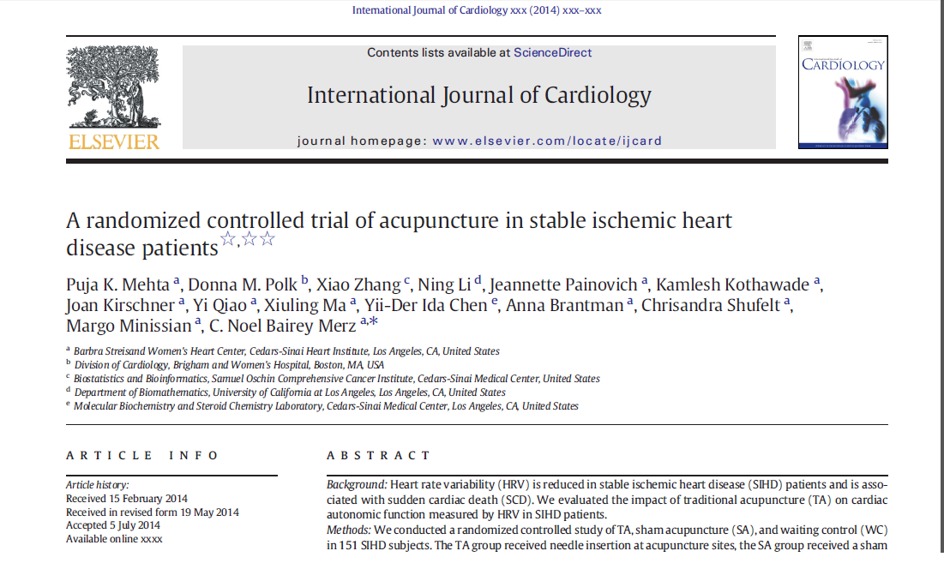
Acupuncture HRV and Coronary Artery Disease
http://www.ncbi.nlm.nih.gov/pubmed/25103909
Notes:
This came out a month before my study, and though it’s not a super long time frame, 12 weeks, they did see a decrease in stress over time.

Slide 30
Coronary artery disease, Acupuncture and HRV
151 patients 12 weeks of 3X per week acupuncture
Verum/Sham/Control arm
Verum showed improved vagal activity by 17% over sham acupuncture and control
NO differences in 24-hour or COP HRV, BP, lipids, insulin resistance, hs-CRP, salivary cortisol, PAT, or psychosocial variables.

Slide 31
HRV May Help to
Identify responders versus nonresponders
Show that acupuncture can reduce stress over time in addition to clinical symptom improvement
Notes:
If we could show that acupuncture reduces stress over time that would be huge.

Slide 32
HRV Monitoring Protocol
Use Vivosense software with artifact correction
Nonin pulse oximeter.
Notes:
Over the years I changed my protocol, changed the equipment. Part of the challenge is to have a protocol that I can manage in the clinic as well as running the practice.
Using a foot probe. I did a number of studies in the interim and presented them as posters. Links in the handout.
Using vivosense

Slide 33
Causing/Capturing the healing shift
Notes:
As we’ve all seen in practice, when you cause a patient to heal, especially in a dramatic way, it is the height of elegance.

Slide 34
How to Capture Response
What is the most significant change?
1st to second 5 minute segment
Immediately on needling?
Notes:
Short hand for the response

Slide 35
Do different needling strategies make a difference to HRV profiles and stress reduction ?
Can we change nonresponders to responders?

Slide 36
Do different needling strategies make a difference to HRV profiles and stress reduction ?
Can we improve the intratreatment HRV profile?

Slide 37
Do different needling strategies make a difference to HRV profiles and stress reduction ?
By improving the HRV profile during treatment(relaxation response), will we improve results and evoke lower stress over time?

Slide 38
28 Yr Old Female Headache
Notes:
Profound responder Within 4 treatments, feeling better not having to take medication, and even her nasal congestion was better
This is what you want to see, a relaxation response
This is the protocol, trying to get a more quantitative sense of response

Slide 39
28 Yr Old Female Headache
Notes:
Used an assymetric needling technique needle sensitive, it made sense

Slide 40
28 Yr Old Female Headache

Slide 41
60 yr old Female: Anxiety and Regional Pain
Notes:
Needle sensitive

Slide 42
60 yr old Female: Anxiety and Regional Pain

Slide 43
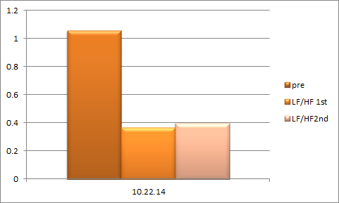
60 yr old Female: Anxiety and Regional Pain
Notes:
Changed the treatment to a protocol using scalp acupuncture for PTSD

Slide 44
HRV May Help to
Identify clinical responders versus clinical non-responders
Show that acupuncture can reduce stress over time in addition to clinical symptom improvement
Optimize needling and treatment strategies
Notes:
The basics of what I hope to get across today is that the third of which is still quite speculative, so I hope we have time to get into that topic
I also hope to have time to discuss some applicability going forward with some new technologies being developed
I am fully aware that these studies are descriptive and far from air tight with no blinding, sham controls etc…

Slide 45
Going Forward: Needling Strategies to Investigate
Auricular acupuncture
Electro acupuncture
Ear tacks
Intervals of treatment
Other indwelling/injection methods
Notes:
Individual
It may be that interval is important.
Can we help guide treatment to help make it more skillful, more dramatic so is less inconvenient for the patient?
Can we adjust treatment to cause the biggest decrease
If we can intensify the response, it may finally be distinquished from placebo. The effect may be weak because of inadequate dosage, skill or needling position
individual

Slide 46
Acupuncture: Elegant Solution
Notes:
We have all seen the dramatic results with acupuncture, but we’ve also seen the dismal results. The Holy Grail to me is one word

Slide 47
Can We Make Our Acupuncture Results Reproducible?

Slide 48
Can We Make all Patients Profound Clinical Responders?

Slide 49
Contact Information
Kristen Sparrow, MD
2000 Van Ness Avenue Suite 310
San Francisco, California 94109
Email: ksparrowmd@gmail.com
Website: ksparrowmd.com

Slide 50
Acupuncture, HRV and Constipation Study
Study out of China showing
Electroacupuncture at st36, cv6, st 25, st28, for 8 sessions over 8 weeks versus sham (light epidermal in and out needling at nonacupoints)
Verum group showed improved HRV over 8 week period along with improved symptomatology
Sham group showed no difference in HRV and no improved symptomatology

Slide 51
Acupuncture HRV and Coronary Artery Disease
The TA and SA groups received 3 treatments/week for 12 weeks.
24-Hour, mental arithmetic stress, and cold pressor (COP) HRV was collected at entry and exit, along with BP, lipids, insulin resistance, hs-CRP, salivary cortisol, peripheral endothelial function bytonometry (PAT), and psychosocial variables.
Acupuncture improved HRV at exit during mental stress challenge
Notes:
24-Hour, mental arithmetic stress, and cold pressor (COP) HRV was collected at entry and exit, along with BP, lipids, insulin resistance, hs-CRP, salivary cortisol, peripheral endothelial function bytonometry (PAT), and psychosocial variables.
Acupuncture improved HRV at exit during mental stress challenge
24-Hour, mental arithmetic stress, and cold pressor (COP) HRV was collected at entry and exit, along with BP, lipids, insulin resistance, hs-CRP, salivary cortisol, peripheral endothelial function bytonometry (PAT), and psychosocial variables.
Acupuncture improved HRV at exit during mental stress challenge
24-Hour, mental arithmetic stress, and cold pressor (COP) HRV was collected at entry and exit, along with BP, lipids, insulin resistance, hs-CRP, salivary cortisol, peripheral endothelial function bytonometry (PAT), and psychosocial variables

Slide 52
Acupuncture, HRV and Constipation
Am J Chin Med. 2013;41(2):301-13. The influence of electro-acupuncture stimulation to female constipation patients. Chen CY1, Ke MD, Kuo CD, Huang CH, Hsueh YH, Chen JR
Showed a decrease in their LF and increase in HF over the 8 week period
Verum acupuncture group also had improvement in their constipation
For the electro-acupuncture (EA) group, needles were inserted into their Zusunli (ST36), Shangiuxu (ST37), Tiensu (ST25), Shueidao (ST28), Guanyuan (CV4) and Qihai (CV6) points.

Slide 53
Do different needling strategies make a difference to HRV profiles and stress reduction ?
Implemented monitoring a baseline for 5 minutes at least
Careful record of needling points and technique
Variation of needling strategies to compare HRV profiles
Data analysis and recording takes 10 to 15 minutes
Notes:
Because I cannot do controlled studies, I have tried to compare outcomes and now treatment strategies. Focusing on now using the protocol is different needling strategies and I will show a few examples and this year instituted a baseline measurement and careful record keeping of each acupuncture treatment. Still have to consider retrospectively. So here are a few of the examples for

Slide 54
HRV May Help to
Identify clinical responders versus clinical nonresponders
Optimize needling and treatment strategies
Show that acupuncture can reduce stress over time in addition to clinical symptom improvement
Notes:
If we could show that acupuncture reduces stress over time that would be huge.

Slide 55
Why is Heart Rate Variability relevant to acupuncture?
By gathering this relatively easy to obtain data may help frame research questions to help target hard to get research funding
Notes:
I would like to impress before we go further with my story, why I think HRV is relevant to acupuncture this is all in the handout with references
Frame research questions towards more fruitful ones
I started exploring HRV in my clinic years ago because of a chance lecture I heard by Robert Sapolsky. What he said was simply that stress affected Mood, Pain, Immune function, and aging. All of these are affected by acupuncture also, so I started using HRV and skin conductance to measure stress in the clinic. What I expected to find was that patients’ stress might decrease over time. What I found instead, was that the patient’s whose HRV showed a “relaxation response” or a decrease in stress in response to the needles, were patients who were more likely to get better with treatment. Skin conductance did not correlate to the same degree as HRV, so I stopped measuring it.

Slide 56
HRV in Ancient Times
“Variable heartbeat has been considered a sign of good health since the third century by oriental physicians and the scientist Wang-Shu Ho. Ho stated, “If the pattern of the heartbeat becomes regular as the tapping of woodpecker or the dripping of rain from the roof, the patient will be dead in four days.”
Ahn AC, Nahin RL, Calabrese C, et al. Applying Principles from Complex Systems to Studying the Efficacy of CAM Therapies. J Altern Complement Med. 2010;16(9):1015–22.

Slide 57
39 Yr old Female: Migraine

Slide 58
Why is Heart Rate Variability relevant to acupuncture?
If we can show a change in HRV/stress it would help convince skeptical colleagues and patients alike
Notes:
I would like to impress before we go further with my story, why I think HRV is relevant to acupuncture this is all in the handout with references
Frame research questions towards more fruitful ones
I started exploring HRV in my clinic years ago because of a chance lecture I heard by Robert Sapolsky. What he said was simply that stress affected Mood, Pain, Immune function, and aging. All of these are affected by acupuncture also, so I started using HRV and skin conductance to measure stress in the clinic. What I expected to find was that patients’ stress might decrease over time. What I found instead, was that the patient’s whose HRV showed a “relaxation response” or a decrease in stress in response to the needles, were patients who were more likely to get better with treatment. Skin conductance did not correlate to the same degree as HRV, so I stopped measuring it.

Slide 59
Auricular Acupuncture
Auricular branch of the vagus nerve in cymba concha and cavum concha 50%
Can we improve HRV profile adding in at end

